Slide 1
TITLE OF IDEA / PROJECT: REAL TIME HEALTH MONITORING , ALERTING USING IOT SENSORS , CLOUD COMPUTING & PREDICTING THE FUTURE USING AI PLACE: MADURAI E-MAIL: yogeshwaranchandrasekaran@gmail.com ritu.skumar25@gmail.com PHONE: 8610482588 , 8344555255

Slide 2
PROBLEM STATEMENT:
Health, as defined by the World Health Organization (WHO), is "a state of complete physical, mental and social well-being and not merely the absence of disease or infirmity.“
It's indeed a challenging one for us to maintain health in day to day factor's & life style as effect of diseases getting increased.
So Patient's under severe monitoring circumstance's have to be monitored regularly and alerted immediately if any problem occurs for them.

Slide 3

PROBLEM STATEMENT:
Thus the problem here is to how quickly the patient's can be monitored and alerted under abnormal conditions.

Slide 4
SOLUTION DESIGN:
The plan here is to use a Wristband / Smart Cloth which helps in sensing the body vital organ and real time monitoring of the health.
The data from the device's are made to be stored in the server.
The Hospital management is made to monitor the data and the real time updation of the data happens.
“THE PROGRAM FOR RETRIEVING DATA FROM SENSOR TO ANDROID VIA BLUETOOTH IS ATTACHED IN THE GITHUB”

Slide 5
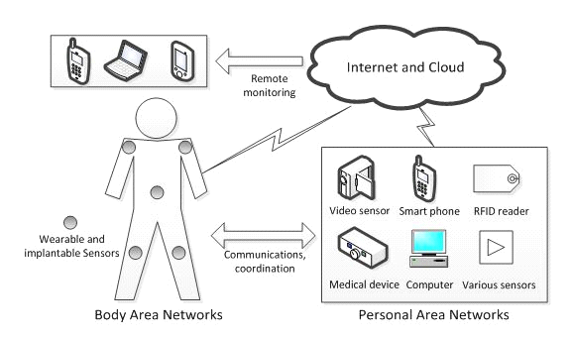

Slide 6
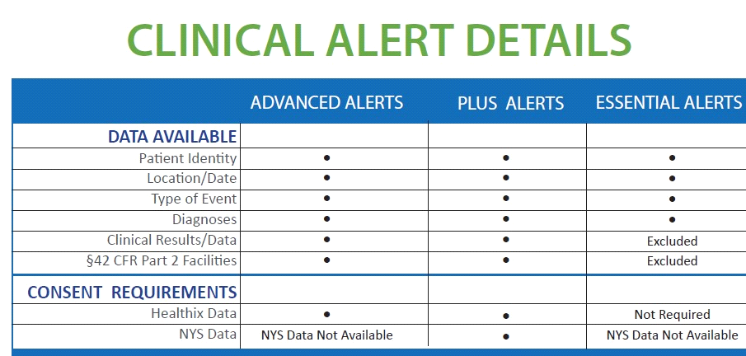
SOLUTION DESIGN:
The alertment is made to be done.
The Patient's with critical condition is made to be monitored regularly.

Slide 7
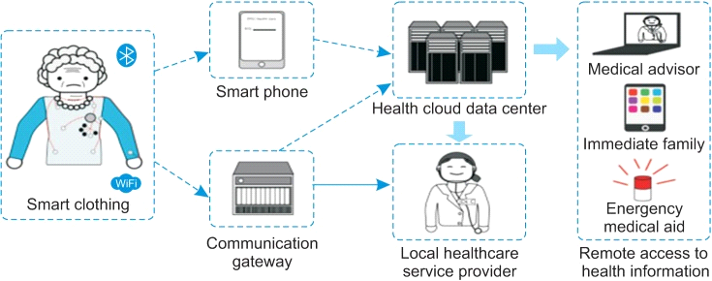
SOLUTION DESIGN:
If incase of any abnormal condition in the patient like abnormal heart beat or blood pressure an alert is made to the Hospital management.
"THE ALERT CAN BE MADE THROUGH ALARMING OR VIA NOTIFICATION SENSORS"

Slide 8
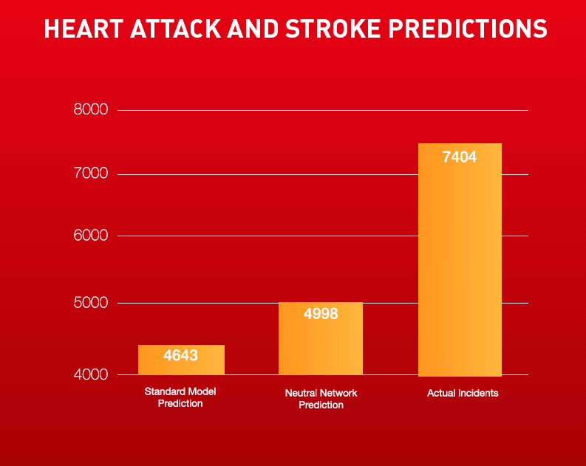
APPLYING ARTIFICIAL INTELLIGENCE:
The real time monitoring of the data and the previous record of data of the particular patient is already made to store in the server.
Now the dataset of patient's having similar issue were taken and the prediction is made of the future recovery of the patient.
"DATASET FOR HEART DISEASE AND STORKE PREVENTION IS ADDED TO THE GITHUB"

Slide 9
UNIQUENESS OR VALUE PROPOSITION:
With advanced development in the field of science & technology it is possible for us to monitor & alert the illness and safeguard the person.
By applying IOT & Cloud Computing with reference to the Big Data we can potentially solve the health problems.
By applying Artificial Intelligence with the help of dataset of previous records the disease can be sensed and the prior solution's can be made thus the real time problem can be fixed.

Slide 10
CURRENT STATE OF DEVELOPMENT:
Concept (poc) ready
The Prototype is not yet ready.

Slide 11
COST OF PROTOTYPE DEVELOPMENT:
We have just ideated and not with the development of the prototype.

Slide 12
TIME TO BUILD PROTOTYPE OR PRODUCT:
Nearly 3 months

Slide 13
MENTOR / ADVISOR:
We don’t have a team mentor or a advisor as we did it by ourself

Slide 14
INCUBATION SUPPORT:
Yeah we are looking for incubation support.

Slide 15
ALGORITHMS/MODEL/TECH STACK USED:
Wrist band / Smart Cloth for sensing the health.
IOT to send data to the server & for notifying and alarming.
AI for predicting the future and the diagnosis needed in the future.

Slide 16
THANK YOU
CONTACT DETAILS:
TEAM NAME: Riyo
TEAM MEMBER’S: N.C.Yogeshwaran(Final/CSE)
S.Ritika(Final/IT)
COLLEGE NAME: Kalasalingam Institute of Technology
GITHUB LINK: https://github.com/Yogeshwaranchandrasekaran/IOT
DETAILS OF MEMBER 1:
NAME:N.C.Yogeshwaran
MAIL ID:yogeshwaranchandrasekaran@gmail.com
PHONE NUMBER: 8610482588
DETAILS OF MEMBER 2:
NAME:S.Ritika
MAIL ID:ritu.skumar25@gmail.com
PHONE NUMBER:8344555255

